Slide 1

IMAGE
DENOISING SYSTEM

Slide 2

Problem Statement
Main Objectives
Outlines
Possible Solutions
Machine Learning Results
Conclusion

Slide 3
Problem Statement
Filter noisy image and generate a clean image for their use in various systems

Slide 4


Main objectives
Improve the Quality of images
Improve the quality of images by removing the noise using different methods.
Least Processing time
Find the ML Algorithm that has the least processing time while filtering noisy images in bulk.
Find the best ML technique
Find the best ML technique to improve the quality of images by removing the noise.

Slide 5

Possible Solutions
Use of Pytesseract
Denoising images using Auto Encoders
Denoising images using ML algorithm - Random Forest Regressor

Slide 6
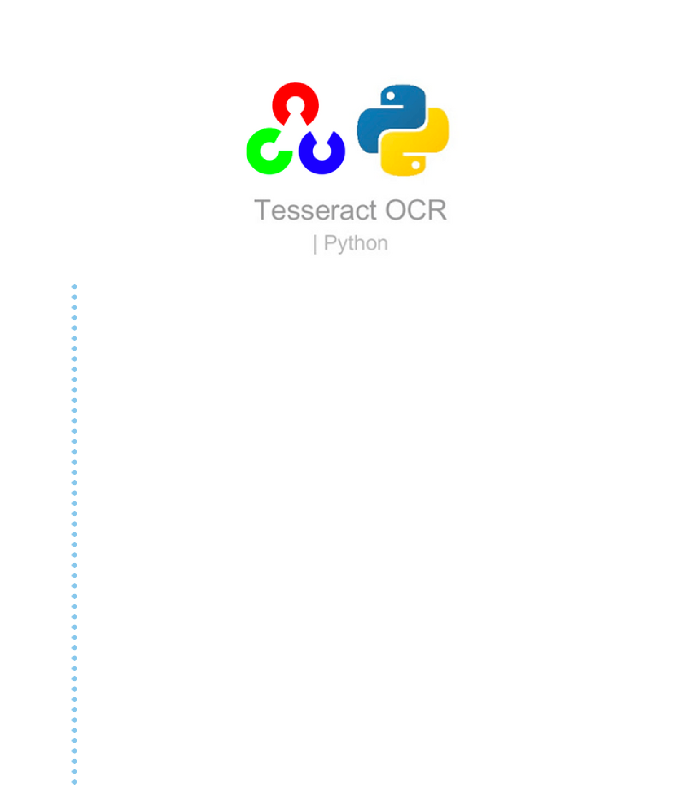

Approach 1: Pytesseract
serves as a wrapper for the Tesseract - OCR Engine
Doesn't detect the text properly when there is noisy background present.
Automatically detect texts from scanned images and displays the output
read and recognize text in images
It possess few gibberish words even after data cleaning
commonly used in python OCR Image to text use cases

Slide 7
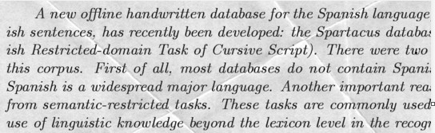

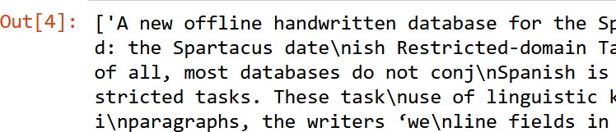

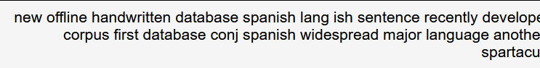
Approach - 1: Pytesseract
SAMPLE IMAGE
SAMPLE OUTPUT
SAMPLE OUTPUT AFTER DATA
CLEANING

Slide 8

Approach 2: Auto Encoders
uses neural networks to create a new representation of the input data as per requirements
computationally expensive
Flexible
Obtained images are of high quality
Unsuitable for running low end systems
used to create cleaned versions of noisy images

Slide 9

Approach 3:
Random Forest Regressor
Pre-Processing of Training Images for testing.
processed in bulk in short period of time
requires tabular data
Predict and generate cleaned text images via RFR.
has low rms value
cleaned images may not be of high quality
prediction accuracy at optimal point

Slide 10

Machine Learning Results

Slide 11
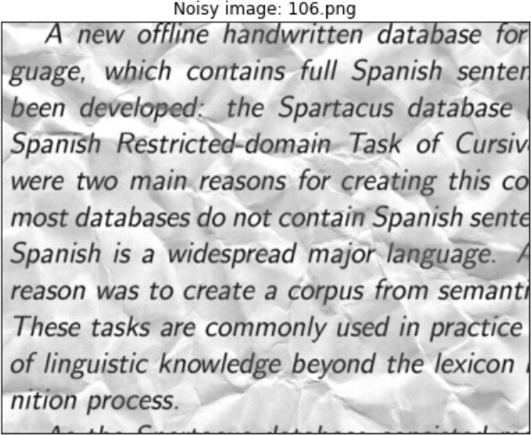
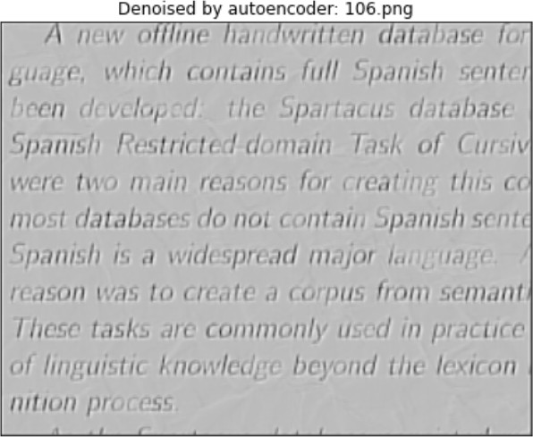
Auto Encoder Results
NOISY IMAGE
CLEANED IMAGE

Slide 12
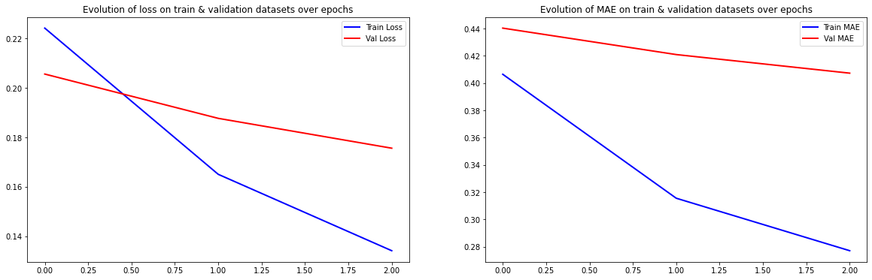
Auto Encoder Results

Slide 13
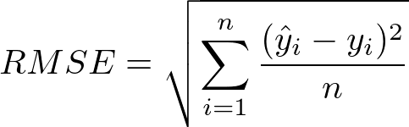
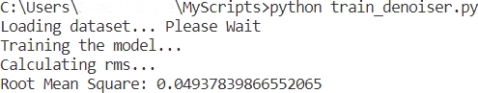
Random Forest Model Results
Set 75% training data and 25% for testing data
Root Mean Square Error ( RMSE) to 0 . 05
our training model was able to accept new noisy image
correctly predict the clean output image with minimal loss of data.

Slide 14
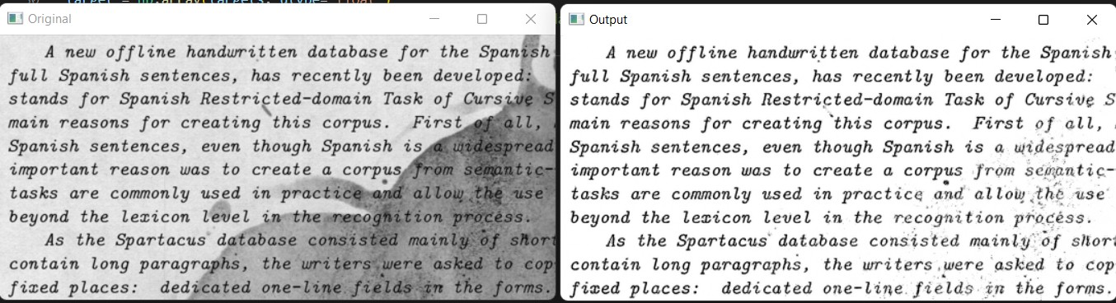
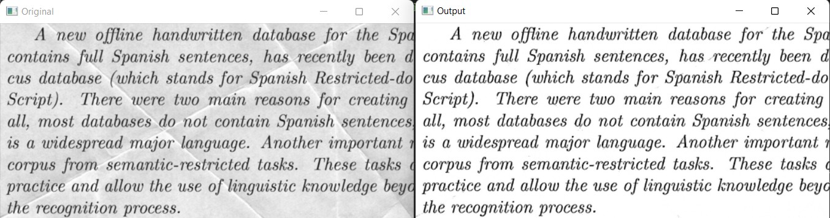
Random Forest Model Results
PAINT BOTCHES CLEANED IMAGE TEXT
PAPER FOLD
CLEANED IMAGE TEXT

Slide 15
Conclusion
If the machine being used is low end, then the random forest approach would be best suited. Else, the CNN method would be best suited to give the best quality output, given that the network can be trained for an optimum number of epochs to obtain a good quality output set of images.

Slide 16

Thank You
Any Questions ?

